Slide 1
Employee Performance Analysis
An in-depth analysis of employee performance and productivity metrics

Slide 2
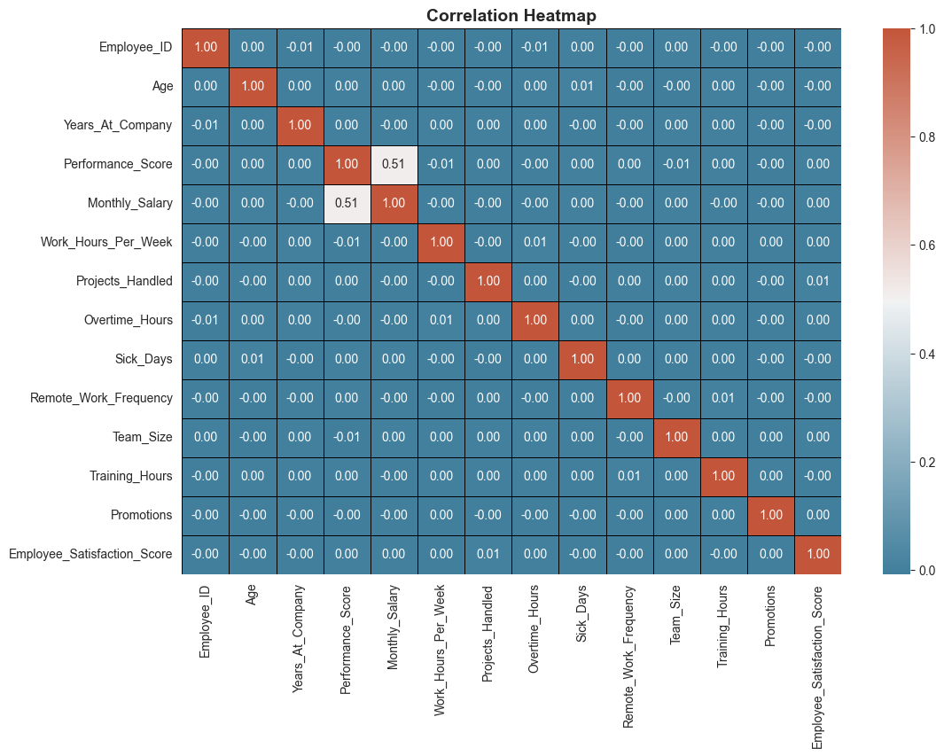
Correlation Heatmap
Findings:
Strong positive correlation between satisfaction score and performance.
Weak correlation between salary and performance.
Years at company have moderate correlation with performance.
Problem:
Some unexpected weak correlations require deeper analysis.
Solution:
Further analysis using regression models to identify hidden patterns.

Slide 3
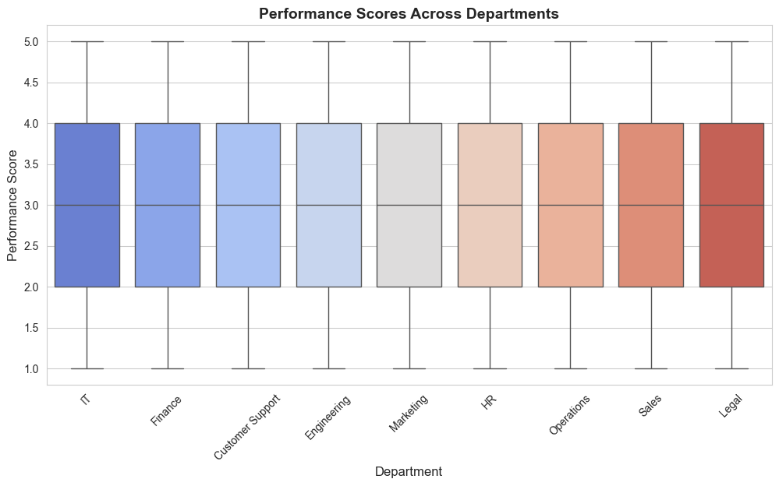
Distribution of Employee Performance Scores
Findings:
Majority of employees have average performance scores.
Few outliers with extremely high or low performance.
Problem:
Skewed distribution may indicate performance inconsistencies.
Solution:
Investigate performance review processes to ensure fairness.

Slide 4
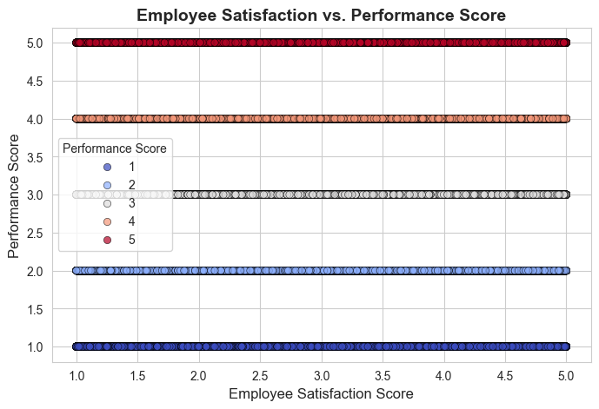
Employee Satisfaction vs Performance Score
Findings:
Employees with higher satisfaction tend to perform better.
Problem:
Some highly satisfied employees still have low performance scores.
Solution:
Identify external factors affecting performance (e.g., workload, role clarity)

Slide 5
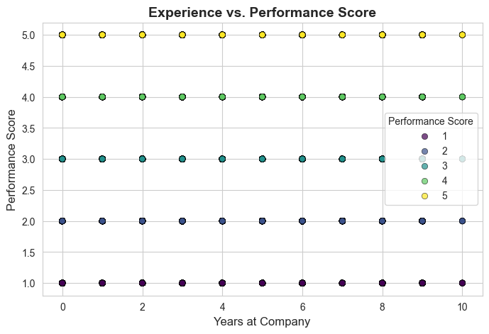
Experience vs Performance Score
Findings:
Employees with more years in the company tend to perform better.
Some new employees perform exceptionally well.
Problem:
Performance inconsistency among long-term employees.
Solution:
Implement continuous training programs to maintain high performance.

Slide 6
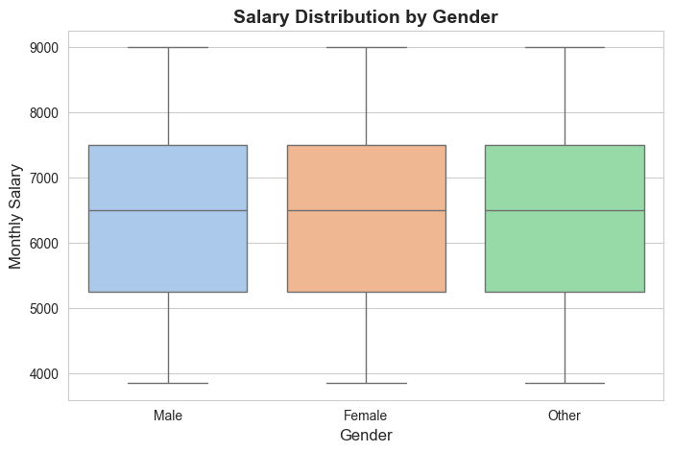
Salary Distribution by Gender
Findings:
No significant gender-based salary disparity.
Problem:
Further analysis needed to ensure equal growth opportunities.
Solution:
Conduct internal audits to maintain pay equity.

Slide 7
Conclusion and Insights
1. Employee satisfaction strongly correlates with performance.
2. Experience has a moderate impact on performance.
3. Gender pay disparities may need further investigation.
4. Departments show varied performance trends.
5. Recommendations: Improve employee satisfaction, address salary gaps, and tailor training programs.

